Slide 1
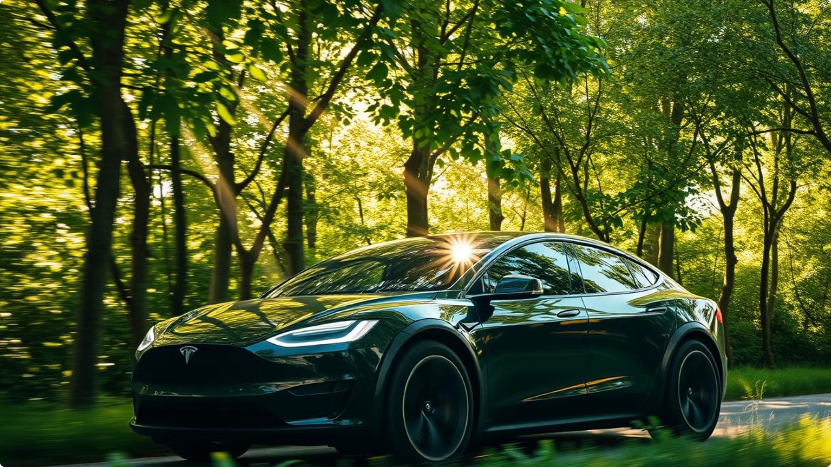
Speculative Campaign for Tesla: "Sustainable Journeys"
This document outlines a mock campaign for Tesla, aimed at promoting its commitment to sustainability and innovation. The campaign seeks to engage environmentally conscious consumers and position Tesla as a leader in sustainable technology.

Slide 2
Campaign Objectives
The campaign aims to achieve several key objectives: increasing brand awareness, engaging environmentally conscious consumers, promoting Tesla's technological innovation, and highlighting community involvement.
1
Increase Brand Awareness
2
Engage Environmentally Conscious Consumers
Strengthen Tesla's position as a leader in sustainable transportation.
Attract a younger demographic interested in sustainability.
3
Promote Technological Innovation
4
Highlight Community Involvement
Showcase Tesla’s developments beyond vehicles - solar energy, battery technology, and energy storage solutions.
Foster a sense of community around sustainability initiatives.

Slide 3
Target Audience
The campaign targets environmentally conscious young adults, aged 18-45, with a middle to upper-middle class income. These individuals are likely to reside in urban areas with a focus on eco-friendly practices.
Demographics
Psychographics
Age: 18-45
Values sustainability, innovation, and technology.
Income: Middle to upper-middle class
Interested in environmental activism, renewable energy, and modern transportation methods.
Location: Urban areas with an emphasis on eco-friendly practices
Active on social media platforms, particularly Instagram, Twitter, and TikTok.

Slide 4
Campaign Theme and Messaging
The campaign theme is "Sustainable Journeys: Drive the Future," with the core message, "Join us in creating a balanced future where travel doesn’t cost the planet." The theme emphasizes the connection between responsible travel and a sustainable future, aiming to inspire individuals to take action.

Slide 5
Digital Media Strategy
The digital media strategy will utilize a multi-platform approach, leveraging social media, video ads, and an interactive website to engage the target audience.
Social Media Campaign
Video Ads
Interactive Website
Interactive challenges will encourage users to share their sustainable travel stories.
A series of short documentaries will highlight real customers using Tesla vehicles in their sustainable lifestyle.
A dedicated landing page will showcase Tesla's sustainable technology, customer impact stories, and interactive maps highlighting popular eco-friendly travel routes.
Instagram
Twitter
Instagram
TikTok
YouTube
TikTok
The website will encourage visitors to calculate their carbon savings by switching to Tesla.
Facebook
Partnerships with influencers and environmental activists will promote the campaign.
The videos will feature engaging and well-edited narrative stories.

Slide 6
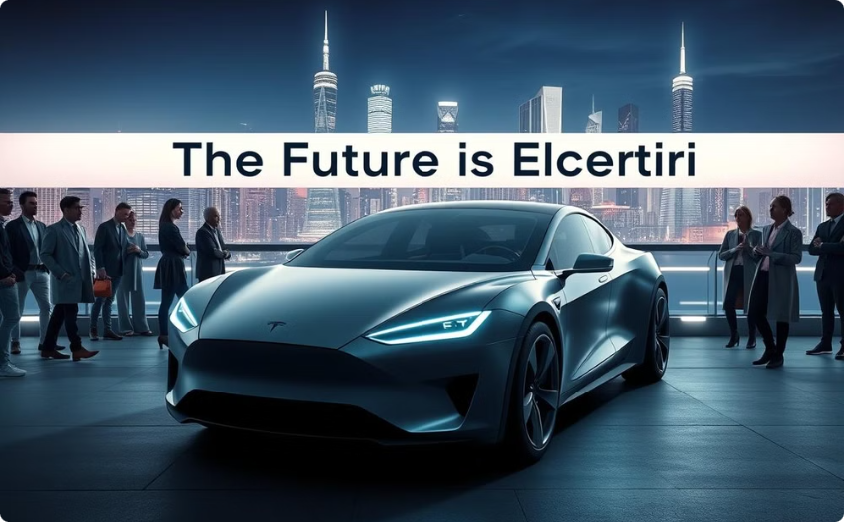
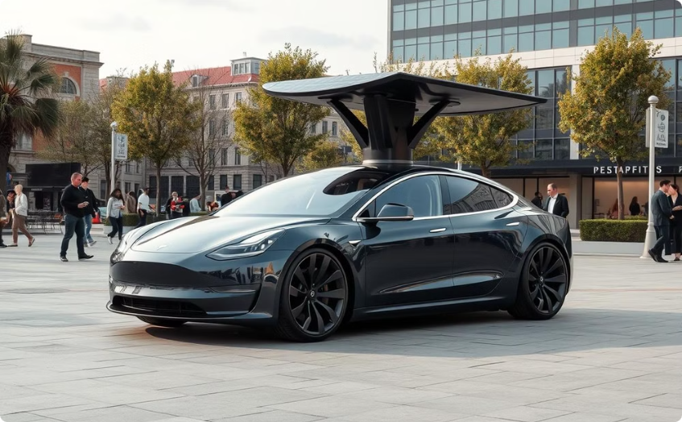
Guerrilla Marketing Tactics
Guerrilla marketing tactics will create unique experiences and generate buzz around the campaign. These tactics will involve pop-up events and urban installations.
Pop-up Events
Urban Installations
These will offer EV test drives and educational workshops about sustainable practices and Tesla technology in urban areas.
These will be placed in major cities, depicting the challenge of carbon footprints and featuring life-size Tesla models powered by solar panels.

Slide 7

PR and Outreach
Public relations and outreach efforts will involve press releases, partnerships, and collaboration with environmental NGOs. These will amplify the campaign's message and build strong relationships with key stakeholders.
1
Press Releases
2
Partnerships
Partnership with environmental publications will spread awareness of the Sustainable Journeys campaign, highlighting Tesla’s commitment to sustainability.
Collaboration with environmental NGOs to co-host events or workshops emphasizing sustainable transportation solutions.

Slide 8
Measurement and KPIs
The campaign's success will be measured through various key performance indicators (KPIs), including engagement metrics, website analytics, and sales metrics.
Metrics
Description
Engagement Metrics
Track likes, shares, comments, and interactions on social media platforms.
Website Analytics
Monitor traffic to the campaign landing page, user engagement metrics, and the number of carbon savings calculators used.
Sales Metrics
Track any increase in Tesla vehicle sales and leasing during and after the campaign.

Slide 9

Budget Breakdown
The estimated total budget for the "Sustainable Journeys" campaign is $130,000, allocated to various aspects of the campaign.
Item
Estimated Budget
Social Media Advertising
$50,000
Video Production
$30,000
Guerrilla Marketing Events
$20,000
Web Development
$15,000
Press and Outreach
$10,000
Contingency
$5,000

Slide 10
Conclusion
The "Sustainable Journeys" campaign aims to showcase Tesla's commitment to sustainability while engaging a wider audience. By utilizing a blend of digital marketing, guerrilla tactics, and community involvement, Tesla can solidify its position as a leader in sustainable transportation and technology.

